Slide 1
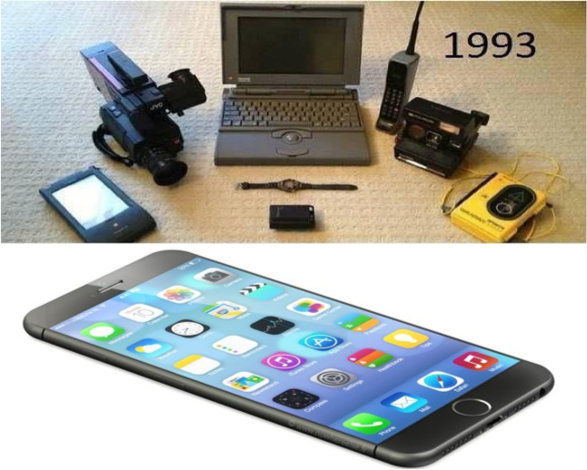







Solving the Information Technology Energy Challenge Beyond Moore’s Law:
A New Path to Scaling

Slide 2
Old Moore’s Law:
2x Transistor Density every 12-24 Months
➔ at same power & consumer cost!
But, in 2016:
2x transistors per 4-5 years
Only 2-3 more cycles?
Industry costs increasing
(need very high volumes)

Slide 3
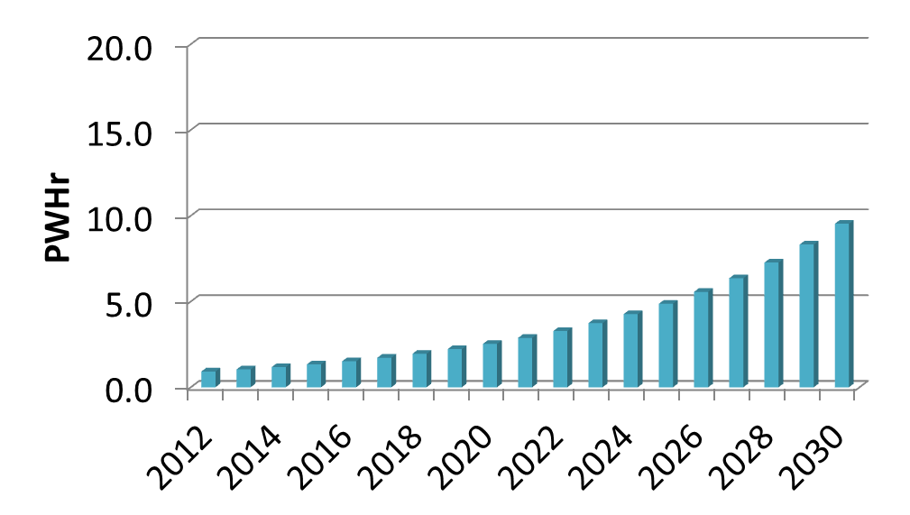
The problem:
IT projected to challenge future electricity supply
(1PW= Million Million kW’s)
~30% of projected world supply
www.alliancetrustinvestments.com/sri-hub/posts/Energy-efficient-data-centres
www.iea.org/publications/freepublications/publication/gigawatts2009.pdf
Notes:
The problem we face is that IT is the fastest growing consumer of energy and greatly outpacing growth in capacity. And I suspect that any of you that have teens of tweens at home for sure know that this demand is not going to go away any time soon. Projecting this out to 2030, we see that at current electric capacity growth rates, IT will be consuming 30% of the projected supply by 2030. And, in fact, this is an optimistic picture.

Slide 4
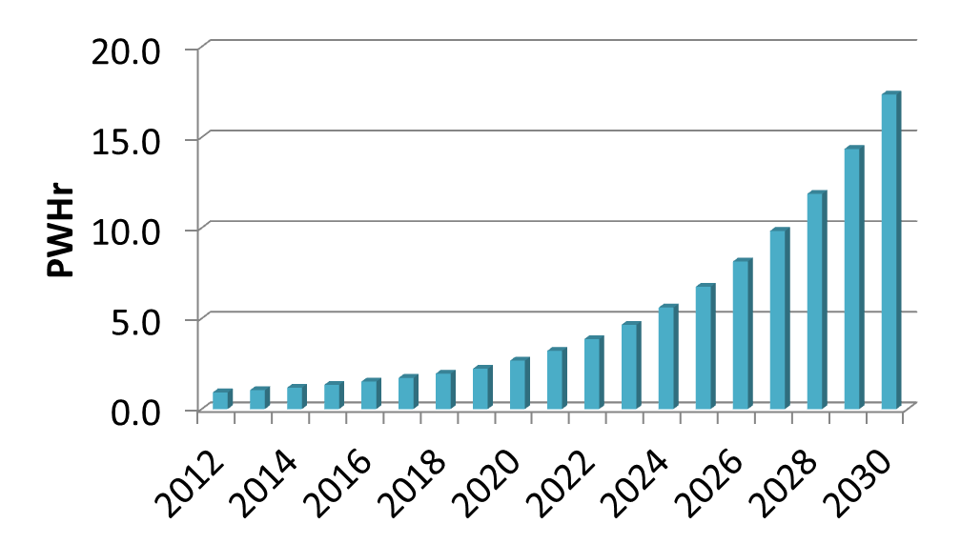
The problem:
IT projected to challenge future electricity supply
~50% of projected world supply
Even worse if Moore’s Law ends!!!
www.alliancetrustinvestments.com/sri-hub/posts/Energy-efficient-data-centres
www.iea.org/publications/freepublications/publication/gigawatts2009.pdf
Notes:
So if Moore’s Law ends and we can no longer offset demand with efficiency gains, the picture becomes even more dire with IT consuming on the order of 50% of the projected electric supply.

Slide 5
The solution:
Double efficiency improvement rates
A New Moore’s Law
www.alliancetrustinvestments.com/sri-hub/posts/Energy-efficient-data-centres
www.iea.org/publications/freepublications/publication/gigawatts2009.pdf
Notes:
So what can we do about it? The answer is to keep Moore’s Law going as long as possible, which we are already doing, but more importantly, to find more fundamental solutions to improved efficiency nominally doubling the computation efficiency improvement rate in the future. This would put us on the trajectory of the green curve. So you might ask are there really that many more gains to be had relative to current technology and the answer is for sure yes, for example, the human brain is about five orders of magnitude more efficient than current technology and spintronic devices have been demonstrated to be six orders of magnitude more efficient.

Slide 6
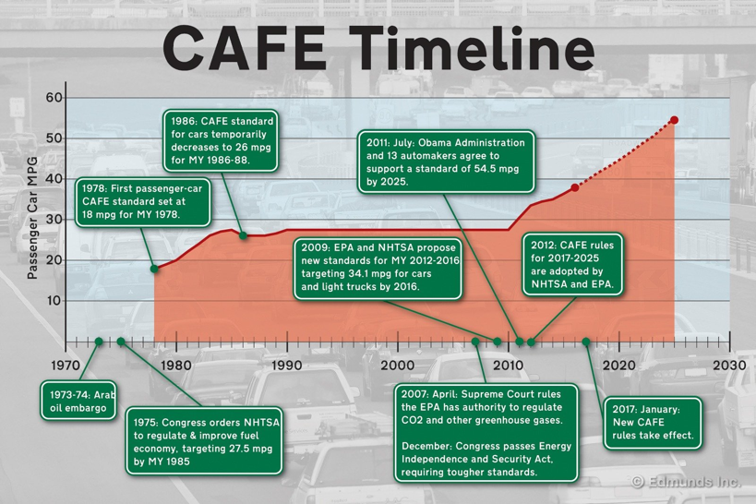
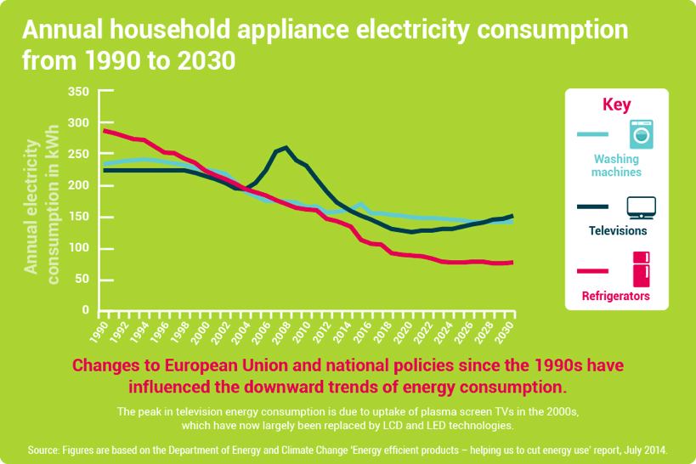
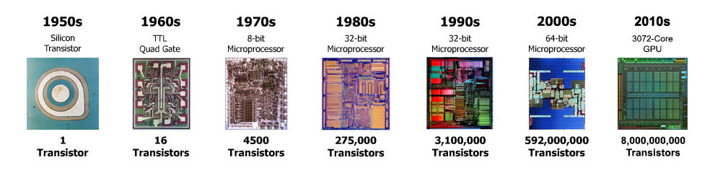
Energy efficiency by Industry often needs gov’t leadership & “motivation”
➔ small improvements will have huge impact: high volumes of electronics
Silicon history: scaling tech for 1M transistor “System on Chip” took 4 decades!
Why DOE? Why Now?
Apliance Energy Consumption
MPG
http://www.computerhistory.org/siliconengine/
Notes:
Why DOE?
Fundamentally an Energy problem
Also a National Security, Economic security, Global Security problem
DOE responsibility: only place with fundamentals, manufacturing, architectures and early adoption
PWHr are very big numbers
energy efficiency is lowest hanging fruit , and given the huge volumes of electronics, improvements have huge impact.
Historically, energy efficiency
isn’t pursued by Industry
without gov’t “motivation” (CAFE, appliance, transportation)
Urgency:
History: takes decades to realize new scalable tech platform
➔ Accelerate progress to 10-20 years

Slide 7












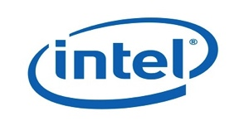




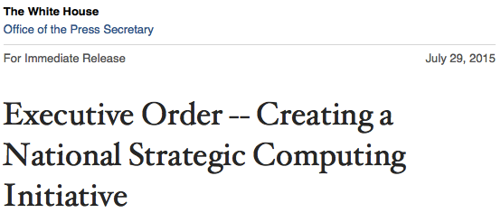
Landscape & Opportunity
Gov’t Agencies
Academia
Industry
NSCI “Lead Agency” Role
HPC “Early Adopter” Role
➔ DOE can accelerate progress by decades
Notes:
This issue has been recognized by the Administrations and Gov’t Agencies, with the NSCI and other activities spurring a frenzy of R&D in materials, devices, and a dizzying array of proposed new computing paradigms from

Slide 8
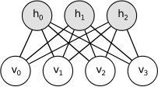
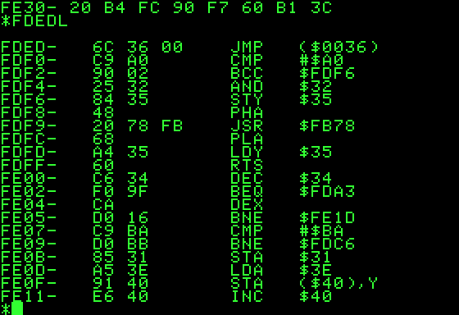



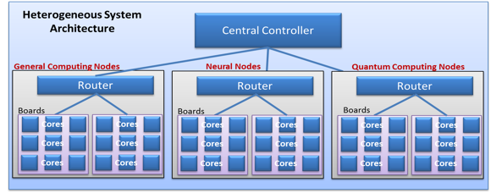



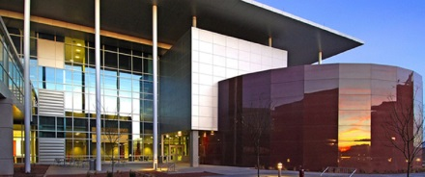

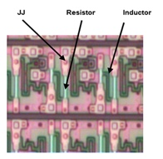


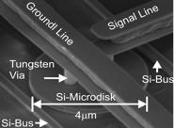




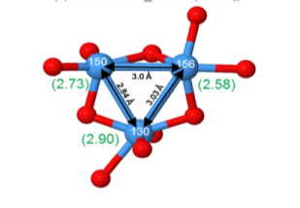
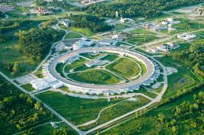


Multiscale CoDesign Framework
Programming paradigms
System architecture modeling
Component hetero-integration
Multiscale CoDesign Framework
MESAFab
Device demonstration
Device physics
Fundamental material science
APS
Notes:
So this really is a multiscale problem that would need a multi-lab effort. Looking at the problem, we start at the bottom fundamental materials science that then feeds into device physics and then up to logic device demonstration followed by large scale heterogeneous integration and then system architecture modeling and finally programming paradigms. All these capabilities currently exist throughout the lab complex.

Slide 9
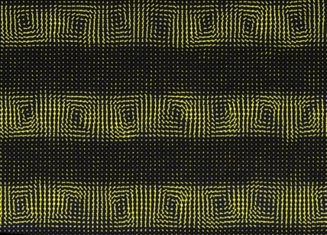
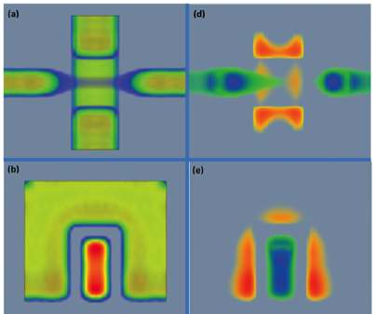
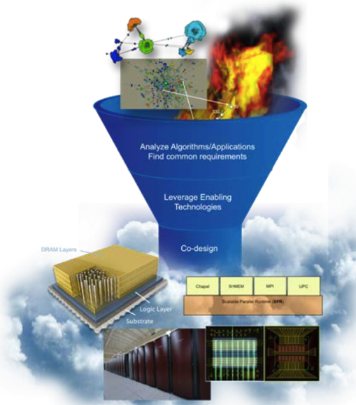

Impact: 10 year goals
Accelerate discovery of optimal materials for energy efficient electronics by factor of 1000x
Discover new devices with manufacturing path for next 30 years of Moore’s scaling
Accelerate discovery and validation of optimal architectures using new device technologies (scale-bridging)

Slide 10







SUMMARY
> 12% savings in world electricity consumption
Looming end of Moore’s Law creating rapidly growing energy gap
Coordinated public-private partnership will drive breakthroughs by leveraging multiple DOE Office leadership and Lab capabilities
These breakthroughs will enable continued affordability of our information economy and US economic competitiveness.
Notes:
SO….
Our Information Economy is in conflict with coming demise of Moore’s Law in Silicon. DOE has an opportunity to lead the national effort to transition to a new information technology platform, by enhancing coordination and communication and by driving the development a new “grand-challenge-level” codesign framework paradigm. Success in this initiative is a coordinated Public-Private Partnership that will accelerate the development of the next “Computing Freeway” to support our Information Economy for the next 40 years.
From the spreadsheet, total energy in 2030 is 33,000 PWhr, of which 9.5 PWhr is ICT related (28.6%).
With Beyond Moore, we assume we can get ~ 2X reduction to 5.3 PWhr, which is 15.9% of 33 PWhr, but this number is ‘fungeable’. (we could assume more).
The reduction of 9.5 – 5.3 = 4.2 PWhr; 4.2 PWhr / 33 PWhr = 12.6%.
The graph is drawn a little lower, but I think it’s ok.
This is achieved with only a 3.5 - 6X reduction in energy per external data rate (Cisco reference) in 2030 vs. the existing trends, the spread depends on the ‘path’ to the energy savings. (greater in early years vs. later years).

Slide 11
Backup

Slide 12



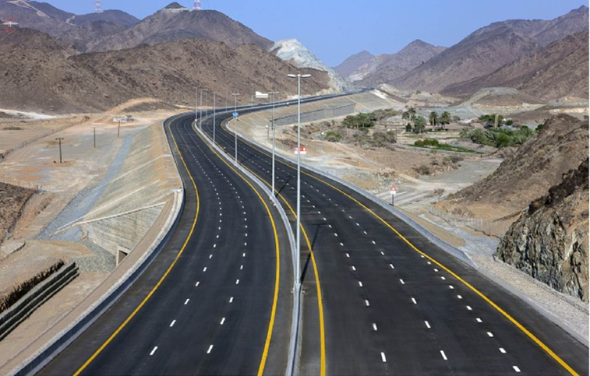
Success is….
Our insatiable thirst for compute cycles is in conflict with coming demise of Moore’s Law in Silicon. DOE has an opportunity to lead the national effort to transition to a new information technology platform, by enhancing coordination and communication and by driving the development a new “grand-challenge-level” codesign framework paradigm. Success in this initiative is a coordinated Public-Private Partnership that will accelerate the development of the next “Computing Freeway” to support our Information Economy for the next 40 years.
Present
Problem
Future

Slide 13
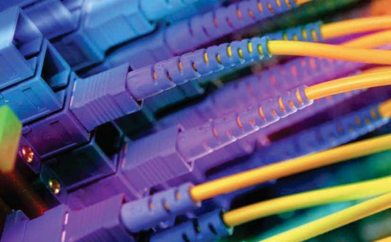
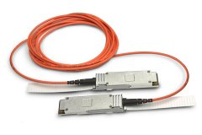
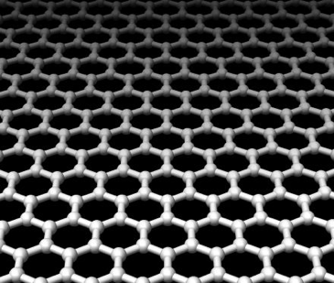
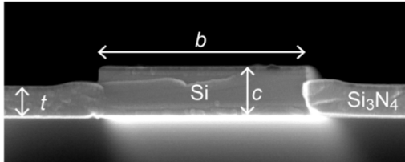
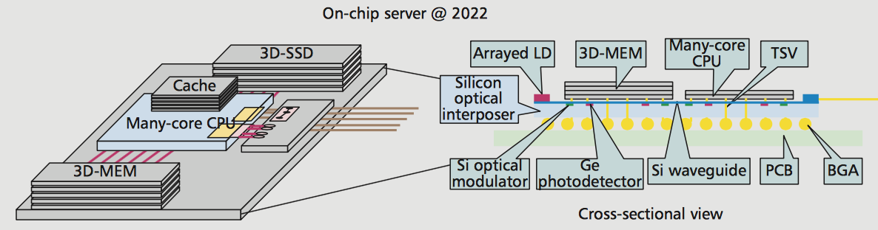
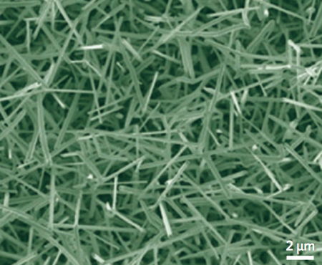
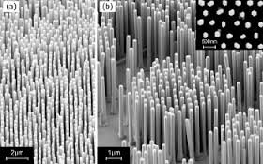



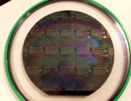


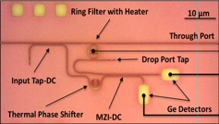




Beyond Moore’s Law Photonics
- > $1/Gb/s
- 25 pJ/bit
Both Too High
10-20 years: Need “Beyond Moore” Photonics
Scale Energy and Cost by 10⁴
  → 1 fJ/bit optics complete (>25,000X equivalent)
  0.01¢ Gb/s ($10¢/Tb/s) (>10,000X equivalent)
New Materials, Devices, Components
Today’s Petascale computing utilize optical transceivers for the ‘network’ interconnect
5 -10 years: Commodity Integrated Photonics
Interface to LV-CMOS and beyond-Moore’s transistor devices
  TFETs, Quantum, Neuromorphic, etc.
Optical switching, routing, computing
Optical modeling infrastructure
  Optical materials, devices → sub-systems → application impact
Hetero-Integrated CMOS photonics manufacturing
Drastically lower the cost of packaging
Higher data rate per optical IO, further reduction
25 pJ/bit → < 1 pJ/bit optics total (> 25X)
$1/Gb/s → 10¢ Gb/s ($100/Tb/s) (10X)

Slide 14







Multi-Lab Engagement (so far…)
Ramamoorthy Ramesh
Patrick Naulleau
John Shalf
Horst Simon
Supratik Guha
Rick Stevens
Jeff Nichols
Gary Grider
John Sarrao
Lou Terminello Nathan Baker
Malin Young
(F.B.) Rick McCormick
Bruce Hendrickson
Dave Sandison
Rob Leland
Trish Damkroger
Jim Brase
Notes:
So far we have built up a very strong partnership on this idea with Sandia and we are also bringing others on board. Argonne and Oakridge participated in the preparations for the red team review and since then we have engaged with several other labs.

Slide 15
SEMATECH was conceived in 1986, formed in 1987, and began operating in 1988^{[1]} as a partnership between the United States government and 14 U.S.-based semiconductor manufacturers to solve common manufacturing problems and regain competitiveness for the U.S. semiconductor industry that had been surpassed by Japanese industry in the mid-1980s.^{[2]} SEMATECH was funded over five years by public subsidies coming from the U.S. Department of Defense via the Defense Advanced Research Projects Agency (DARPA) for a total of $500 million.

Slide 16
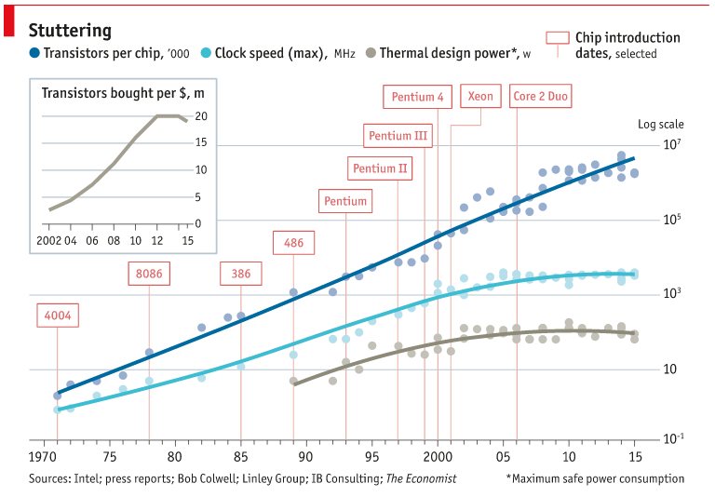
http://www.economist.com/technology-quarterly/2016-03-12/after-moores-law

Slide 17
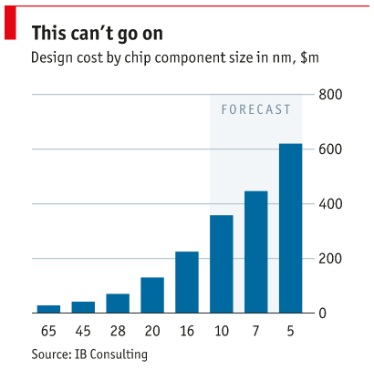
http://www.economist.com/technology-quarterly/2016-03-12/after-moores-law

Slide 18
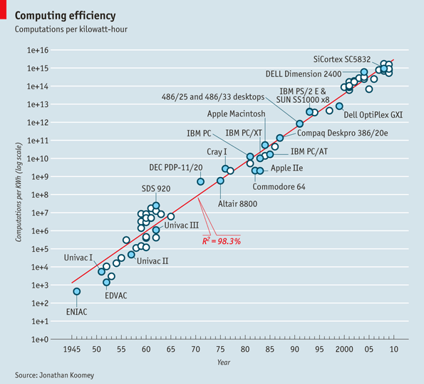
Moore’s Law and energy:
Koomey’s Law
Computations/kW
Computation efficiency doubles every 1.57 years
Year
Notes:
The reality is that Moore’s Law and scaling has been greatly subsidizing our habit with a power law improvement in computing efficiency. This efficiency improvement is actually know as Koomey’s Law. The problem is that we are getting dangerously close to the end of Moore’s Law assuming we are referring to the traditional scaling that has fueled the efficiency gains to date. It’s not really a question of if, just when and not too far away.

Slide 19
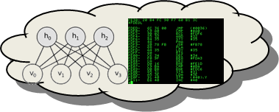

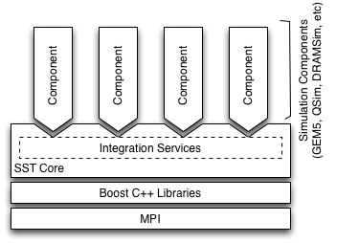
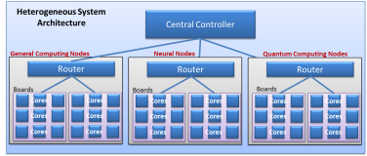
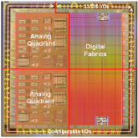

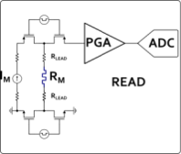
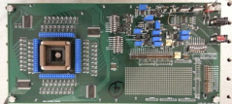
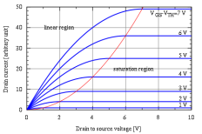
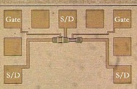


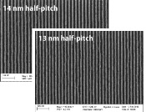
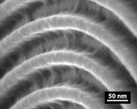
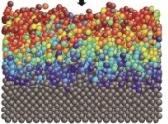

Beyond Moore Codesign Framework
Application Performance Modeling
10,000x improvement:
20 fJ per instruction equivalent
Modeling
Computer System Architecture Modeling
Next generation of Structural Simulation Toolkit
Heterogeneous systems HPC models
Systems
Component Level Models
Gem5, McPAT, HiHAT, CACTI, NVSIM
Component Fabrication
Processors, ASICs
Photonics
Memory
Circuit/IP Block Design and Modeling
SPICE/Xyce model
Test Circuit Fab and Measurement
Subcircuit measurement
Compact Device Models
Single device electrical models
Variability and corner models
Devices
Device Measurements
Single device electrical behavior
Parametric variability
TEM/EELS
Device Physics Modeling
Device physics modeling (TCAD)
Electron transport, ion transport
Magnetic properties
Device Structure Integration and Demonstration
Novel device structure demonstration
Process Module Modeling
Diffusion, etch, implant simulation
EUV and novel lithography models
Process Module Demonstrations
EUV and novel lithography
Diffusion, etch, implant simulation
Materials
Atomistic and Ab-Initio Modeling
DFT – VASP
MD – LAAMPS
Fundamental Materials Science
X-ray: XRD, XPS, HAXPES
Microscopy: TEM, SEM, EELS
Scanning probe technique
Experimental
Notes:
Explain how this integrated framework leverages the labs strength and MISSION, and engages both modeling and experimental science
There are many indiviual activities happening in each of these areas, but there is nothing that integrates them together.
In the Charter of the National Strategic Computing Initiative, the DOE is identified as a lead agency for computing systems,
with a mission to create integrated efforts that LEAD to fully integrated systems.
It is our job… it is our MISSION to address this first order energy challenge...

Slide 20
The Opportunity
Fundamental Science
(BES)
Computing
Science
(ASCR)
Manufacturing
Science
(AMO)
Leverage unique capabilities in material science
Scientific user facilities
Computational approaches to materials design
Grand challenges driven research
Advanced computing
Multiscale computing benchmarking and modeling
Next-generation heterogeneous architectures
New programming models and application software
Move revolutionary low energy devices and architectures
from Lab to Fab
Accelerate development and manufacturing base
for electronic devices
Create public-private partnerships with electronics industry
Notes:
WHY DOE instead of industry?
Big semiconductor companies follow low risk evolutionary approaches: too slow to meet energy needs
Small companies lack the resources and scale for this challenge

Slide 21
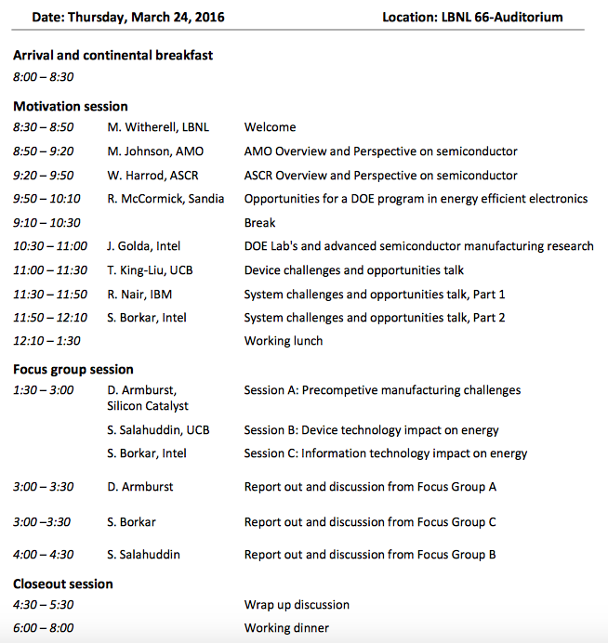
Building the Public-Private Partnership
Notes:
Working apart, we will not reach our goals.
Requrires an integrated effort, and DOE is the right place to do it because they already have the base capabilties in each area
And they have a mission to integrate.

Slide 22











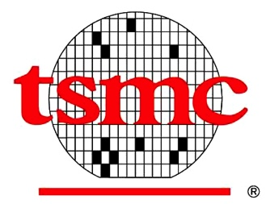







Building the Public-Private Partnership
Workshop held at Berkeley Lab 3/24
Advanced Scientific Computing Research
Notes:
In order to actually deliver on the goal of power savings, it is crucial to partner with industry because ultimately they will need to adopt and mass manufacture whatever solution is developed. Just last week we held our first workshop on the topic and had great interest and participation from industry. They clearly agree that this is a crucial problem and one that is well suited to take on with the DOE.
Now you might ask, why does DOE need to step in?

Slide 23
Quote from industry at workshop:
“industry alone will not solve these challenges”
Industry cannot justify high risk development projects to shareholders
Notes:
Well here is a quote from one of the high level industry participants “industry alone will not solve these challenges”
Basically, industry cannot justify such high risk development projects to shareholders and they cannot afford to individually bet on the wrong path forward.

Slide 24
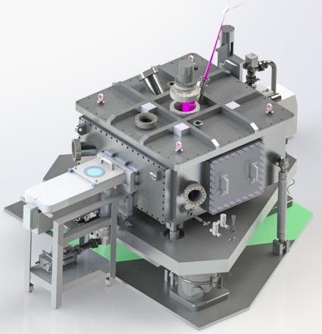
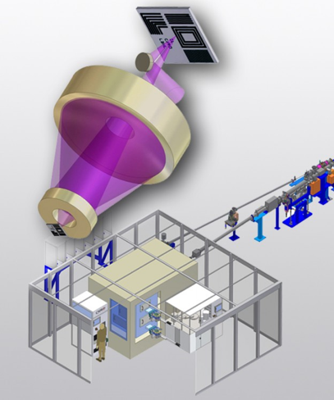




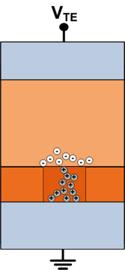
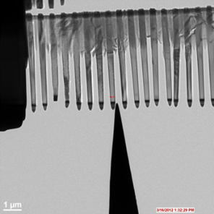
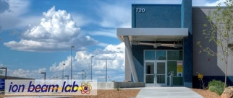


Industry Partnership Examples
EUVL metrology & lithographic materials:
Memristor materials, devices & circuits:
MESAFab
Memristors
Memristor TEM
Future interconnect technologies:
Notes:
We work with Intel, IBM, and AMAT on EUVL metrology using CXRO’s SHARP facility to demonstrate the feasibility of mask technology at the 7 nm node and beyond.
We work with Inpria, Suny Polytechnic, and Cornell on next generation lithographic patterning materials evaluation using CXRO's MET facility enabling the extension of Moore's Law.

Slide 25






Solving the Information Technology Energy Challenge Beyond Moore’s Law
2x transistor/2yrs at same power & cost
Started slowing ~2007
Notes:
Thanks for this chance to discuss a looming energy threat and a new opportunity for DOE to take a leadership position in mitigating this threat. We now use high performance computing for everything: Walmart’s supply chain, Goodyear’s tires, my kid’s cat-videos…and most of the DOE’s current and future initiatives. Part of the reason for this exponential growth is the “free-ride” we’ve been getting from Moore’s Law – steadily increasing performance “at almost no cost” in terms of dollars and energy. But the “Expressway” is turning into a “dirt road”, in the next decade, and continuing our information economy is threatened by the end of Moore’s-law energy scaling (Denard scaling). A group of Labs has mobilized to examine this critical energy issue.

Slide 26
The problem:
IT projected to challenge future electricity supply
~40% of 2014 world electricity
Projection based on consumer electronics + data centers
www.alliancetrustinvestments.com/sri-hub/posts/Energy-efficient-data-centres
www.iea.org/publications/freepublications/publication/gigawatts2009.pdf
Notes:
This is the issue: With our continued growth of information consumption, the current trend of IT energy use appears to become unaffordable in the near future, even with the current Moore’s law energy scaling. Part of the impact of the explosion of “Internet of Things” devices is included in the data center impact, but it may also introduce additional “vampire” loads.

Slide 27
The problem:
IT projected to challenge future electricity supply
Even worse if Moore’s Law ends!!!
Projection based on consumer electronics + data centers
More Moore’s
Big Idea
www.alliancetrustinvestments.com/sri-hub/posts/Energy-efficient-data-centres
www.iea.org/publications/freepublications/publication/gigawatts2009.pdf
Notes:
The situation is likely even worse, given the ending of Moore’s Law scaling. Our partnership will address this critical need by coordinating efforts across the materials-devices-architectures “IT foodchain” to drive the needed breakthroughs for a new technology to enable “More Moore’s Scaling”. A key issue is that current Silicon microelectronics took 25-30 years to mature to the current state that enables our information economy…..and we likely need to accelerate that timeline for this new technology base.

Slide 28
SUMMARY
> 12% savings in world electricity consumption
Looming end of Moore’s Law creating rapidly growing energy gap
Coordinated public-private partnership will drive breakthroughs by leveraging multiple DOE Office leadership and Lab capabilities
These breakthroughs will enable continued affordability of our information economy, and US economic competitiveness.
Notes:
From the spreadsheet, total energy in 2030 is 33,000 PWhr, of which 9.5 PWhr is ICT related (28.6%).
With Beyond Moore, we assume we can get ~ 2X reduction to 5.3 PWhr, which is 15.9% of 33 PWhr, but this number is ‘fungeable’. (we could assume more).
The reduction of 9.5 – 5.3 = 4.2 PWhr; 4.2 PWhr / 33 PWhr = 12.6%.
The graph is drawn a little lower, but I think it’s ok.
This is achieved with only a 3.5 - 6X reduction in energy per external data rate (Cisco reference) in 2030 vs. the existing trends, the spread depends on the ‘path’ to the energy savings. (greater in early years vs. later years).

Slide 29














Landscape & Opportunity
Gov’t Agencies
Academia
Post-Moore activity rapidly growing, but under-coordinated and under-informed
Industry
DOE brings unique capabilities and is uniquely positioned to coordinate, leverage, and build on existing efforts
DOE’s NSCI “Lead Agency” and “Early Adopter” roles provide opportunity to accelerate arrival of post-Moore computing era by a decade or more.
DOE/National Labs
Support
Collaborate
Partnerships
Early Adoption
Notes:
This issue has been recognized by the Administrations and Gov’t Agencies, with the NSCI and other activities spurring a frenzy of R&D in materials, devices, and a dizzying array of proposed new computing paradigms from

